Slide 1
CSE Course: STAT-2111 Course title: Theory of Statistics
Prof. Md. Aminul Hoque, PhD
HP: 01715361973
E-mail: aminul@ru.ac.bd
OR
mdaminulh@gmail.com

Slide 2
Glossaries
What Is Population?
A population is the complete set group of individuals, whether that group comprises a nation or a group of people with a common characteristic.
In statistics, a population is the pool of individuals from which a statistical sample is drawn for a study. Thus, any selection of individuals grouped by a common feature can be said to be a population.

Slide 3
What Is a Sample?
A sample refers to a smaller, manageable version of a larger group. It is a subset containing the characteristics of a larger population. Samples are used in statistical testing when population sizes are too large for the test to include all possible members or observations. A sample should represent the population as a whole and not reflect any bias toward a specific attribute.
There are several sampling techniques used by researchers and statisticians, each with its own benefits and drawbacks.

Slide 4
What is Parameter?
A parameter is a useful component of statistical analysis. It refers to the characteristics that are used to define a given population. It is used to describe a specific characteristic of the entire population. When making an inference about the population, the parameter is unknown because it would be impossible to collect information from every member of the population. Rather, we use a statistic of a sample picked from the population to derive a conclusion about the parameter.
A parameter is used to describe the entire population being studied. For example, we want to know the average length of a butterfly. This is a parameter because it is states something about the entire population of butterflies.

Slide 5
What is Statistic?
A statistic (singular) or sample statistic is any quantity computed from values in a sample which is considered for a statistical purpose. Statistical purposes include estimating a population parameter, describing a sample, or evaluating a hypothesis. The average (or mean) of sample values is a statistic. The term statistic is used both for the function and for the value of the function on a given sample. When a statistic is being used for a specific purpose, it may be referred to by a name indicating its purpose.
When a statistic is used for estimating a population parameter, the statistic is called an estimator.

Slide 6
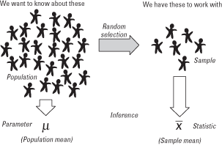
Population and Sample

Slide 7
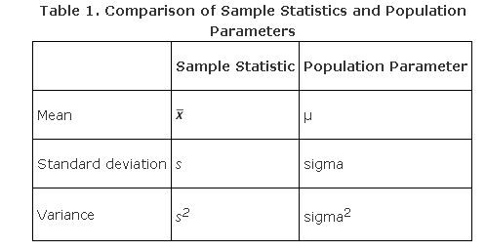
Parameter and Statistic

Slide 8

What is Estimator?
The sample mean is an estimator for the population mean. An estimator is a statistic that estimates some fact about the population.

Slide 9
What is Sampling Distribution?
A sampling distribution is a theoretical probability distribution of a statistic that is obtained through repeated sampling of a specific population. It describes a range of possible outcomes for a statistic, such as the mean or mode of some variables of a population.

Slide 10
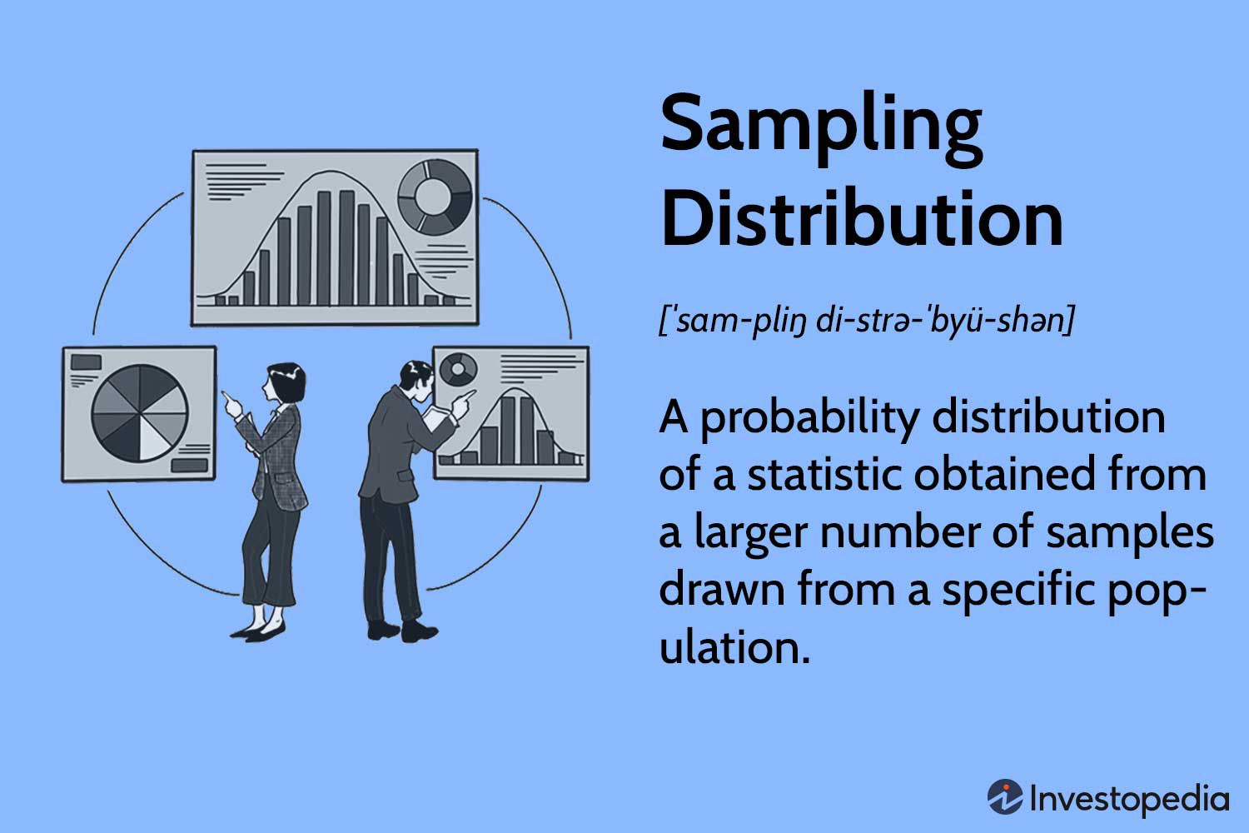

Slide 11
Different Types of Sampling Distribution
There are several sampling distributions. Some of them are as follows:
Chi-square distribution (χ²-distribution)
t-distribution (Student t-distribution)
F- distribution
Normal distribution (z-distribution)

Slide 12
Chi-square distribution (χ²-distribution)
A chi-square (Χ²) distribution is a continuous probability distribution that is used in many hypothesis tests. The Chi-square distribution may be defined as the “Sum of the squares of independent normally distributed variables with zero means and unit variances”.
The square of a standard normal variate is known as a chi-square variate (pronounced as Ki-Sky without S) with 1 d.f.

Slide 13
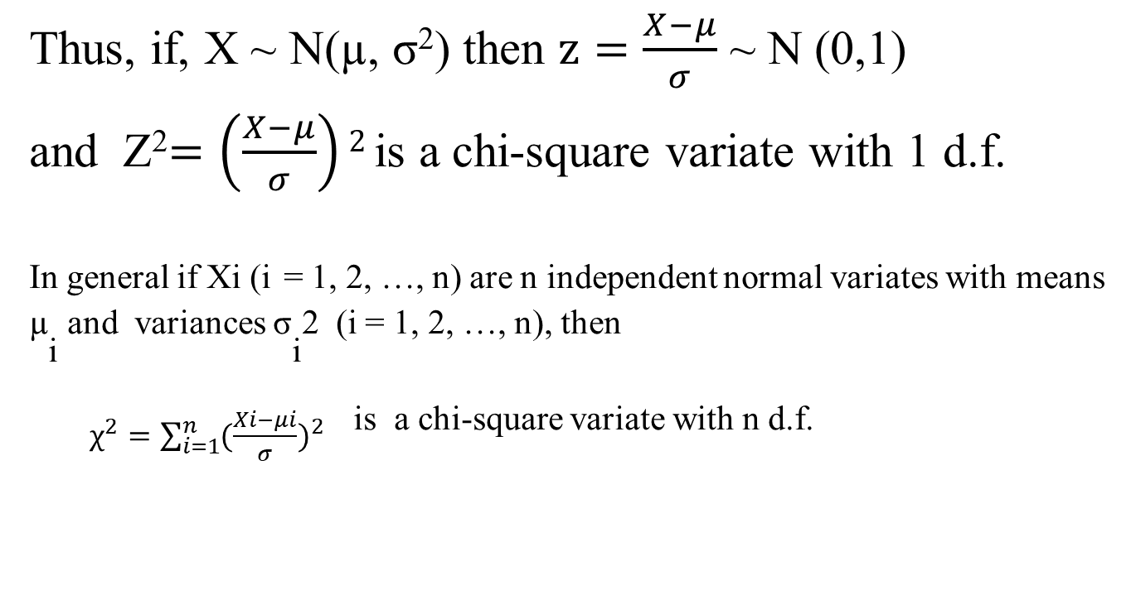
Chi-Square Distribution
Thus, if, X ~ N(µ, σ²) then $z=\frac{X−μ}{σ}$ ~ N (0,1)
and Z²$=\left(\frac{X−μ}{σ}\right)2$ is a chi-square variate with 1 d.f.
^{In general if Xi (i} = 1, 2, …, n) are n independent normal variates with means µ_{i} ^{and variances σ}_{i}^{2 (i = 1, 2, …, n), then}
$χ^{2}=\sum_{i=1}^{n}{{(\frac{Xi−μi}{σ})}^{2}}$ is a chi-square variate with n d.f.

Slide 14
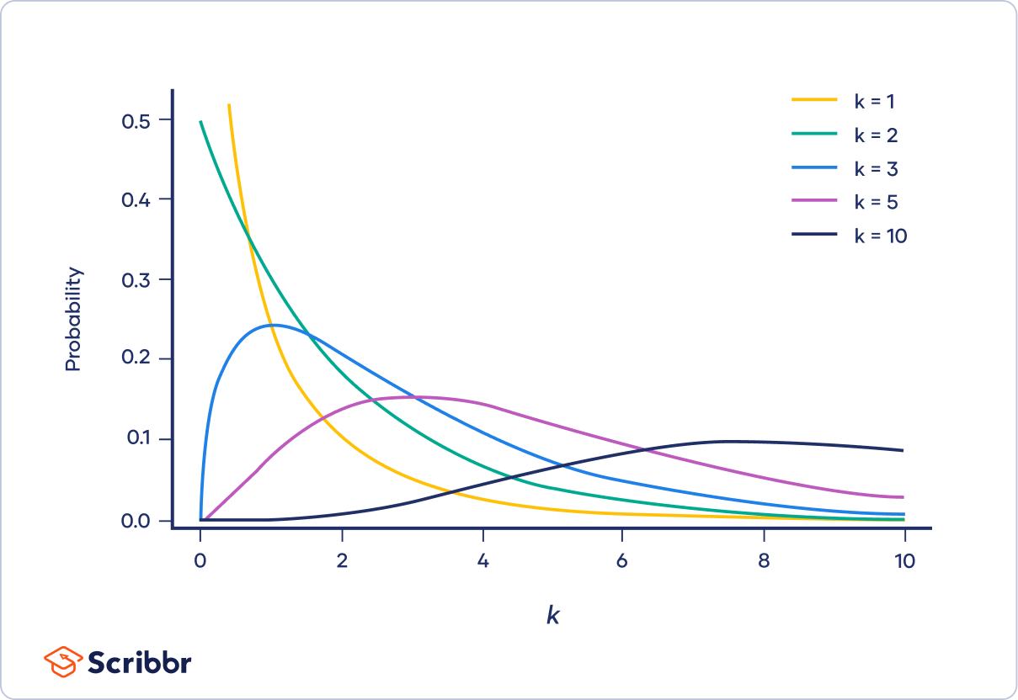
The shape of a chi-square distribution is determined by the parameter k. The graph below shows examples of chi-square distributions with different values of k.

